Slide 1


Statistic
Lecture 3
Dr. Nada Abdullah Rasheed
Assist prof. / Computer Science

Slide 2
Syllabus Content
Subject | Lec. No.
Ogives | 3
Graphs for Frequency Distributions of Quantitative Variables | 6
Graphs for Frequency Distributions of Qualitative Variables | 11

Slide 3
Frequency Distributions and Graphing
2.3 Ogives
For a set of observations, we know how to construct a frequency distribution. In some cases we may require the number of observations less than a given value or more than a given value. This is obtained by an accumulating (adding) the frequencies up to (or above) the give value. This accumulated frequency is called cumulative frequency.
These cumulative frequencies are then listed in a table is called a cumulative frequency table. The curve table is obtained by plotting cumulative frequencies is called a cumulative frequency curve or an ogive. There are two methods of constructing ogive namely:
• The ‘less than ogive’ method.
• The ‘more than ogive’ method.

Slide 4
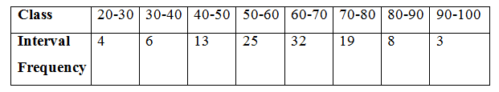
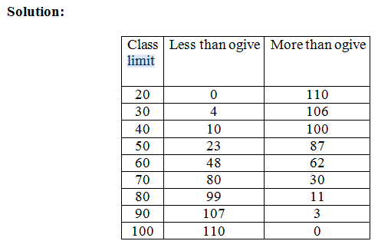
Frequency Distributions and Graphing

Slide 5
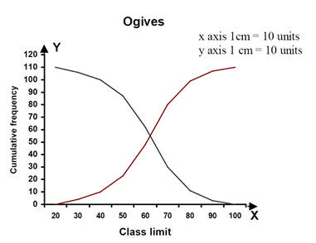
Frequency Distributions and Graphing

Slide 6
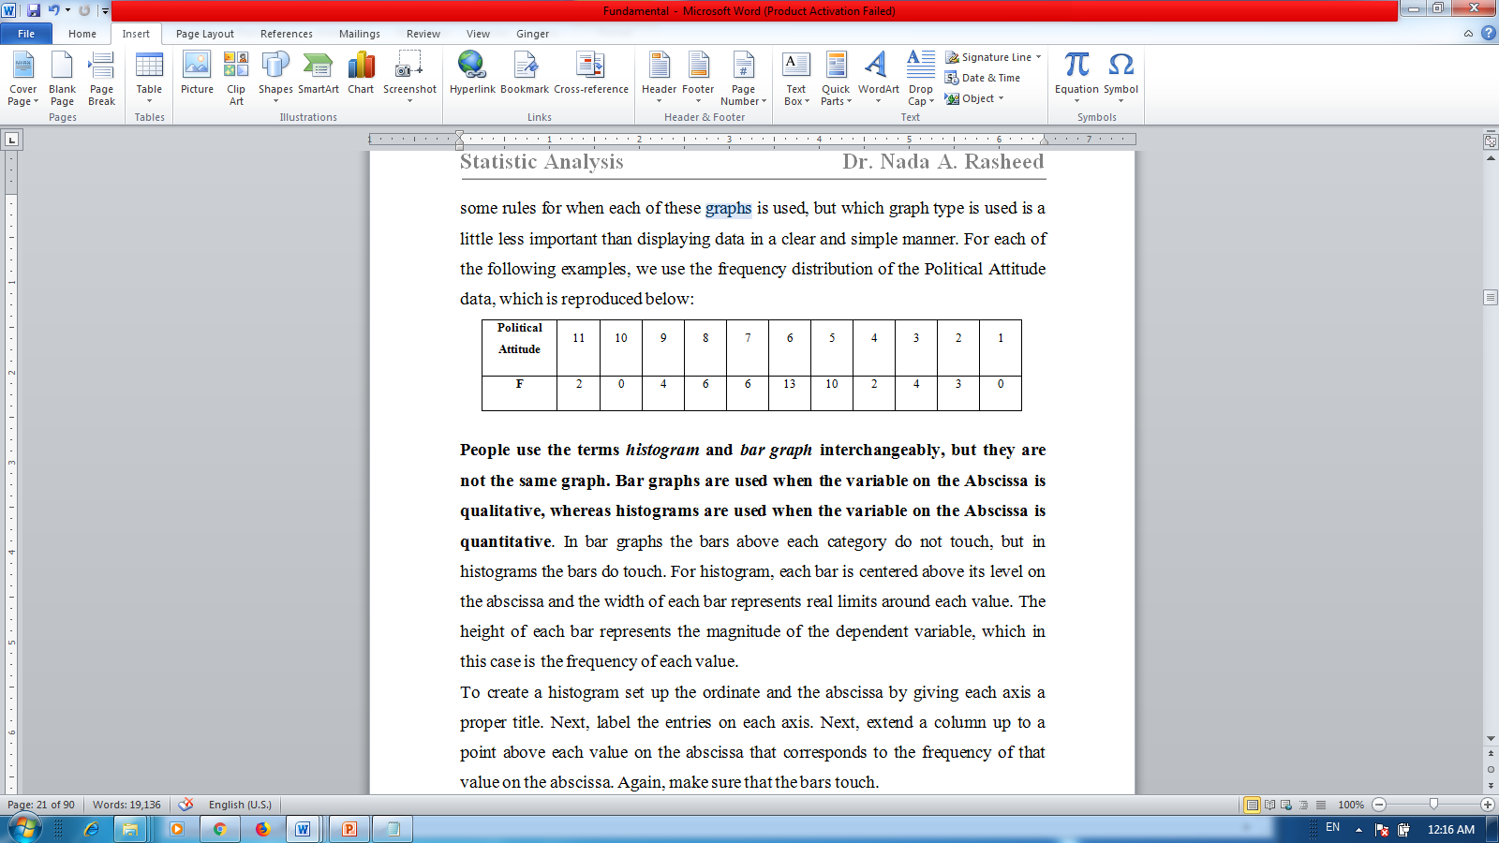
Frequency Distributions and Graphing
2.4 Graphs for Frequency Distributions of Quantitative Variables:
When data are measured on a quantitative variable one of three different graphs are generally used to display the data: histograms, polygons, and line plots. There are some rules for when each of these graphs is used, but which graph type is used is a little less important than displaying data in a clear and simple manner. For each of the following examples, we use the frequency distribution of the Political Attitude data, which is reproduced below:

Slide 7
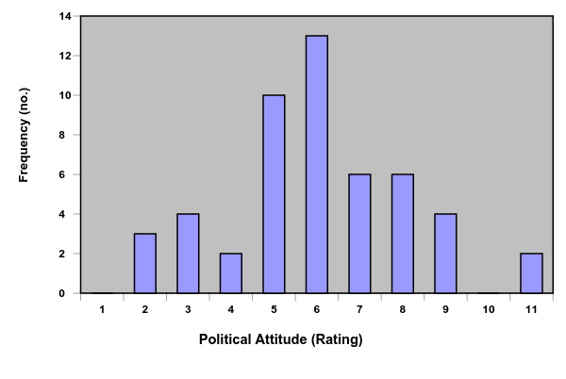
Frequency Distributions and Graphing
People use the terms histogram and bar graph interchangeably, but they are not the same graph. Bar graphs are used when the variable on the Abscissa is qualitative, whereas histograms are used when the variable on the Abscissa is quantitative.

Slide 8
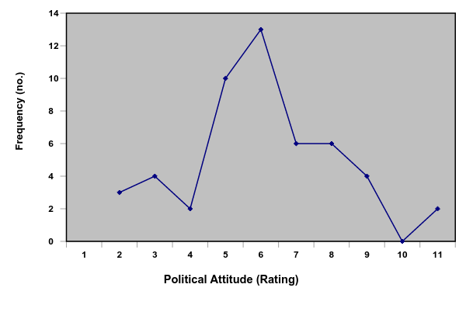
Frequency Distributions and Graphing
A polygon uses the height of lines between data points to represent the magnitude of a dependent variable, instead of columns as in bar graphs and histograms.

Slide 9
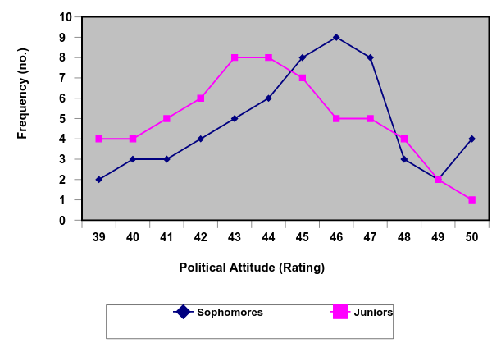
Frequency Distributions and Graphing
Line plots and histograms are also for presenting data from several groups within the same graph, that is, if several groups were measured on the same variable, these groups’ data can be plotted within the same graph.

Slide 10
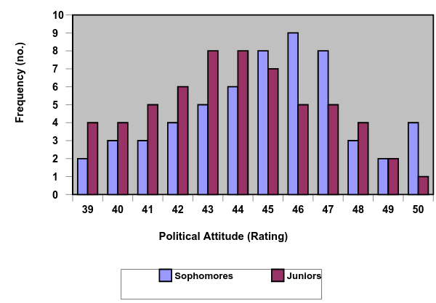
Frequency Distributions and Graphing
Here’s a histogram showing the frequencies of sophomores and juniors who completed.

Slide 11
Frequency Distributions and Graphing
2.5 Graphs for Frequency Distributions of Qualitative Variables :
If the variable displayed on the abscissa is qualitative, a bar graph is used. Bar graphs and histograms look nearly identical, but histograms are used when the variable on the abscissa is quantitative and bar graphs are used when the variable on the abscissa is qualitative.

Slide 12
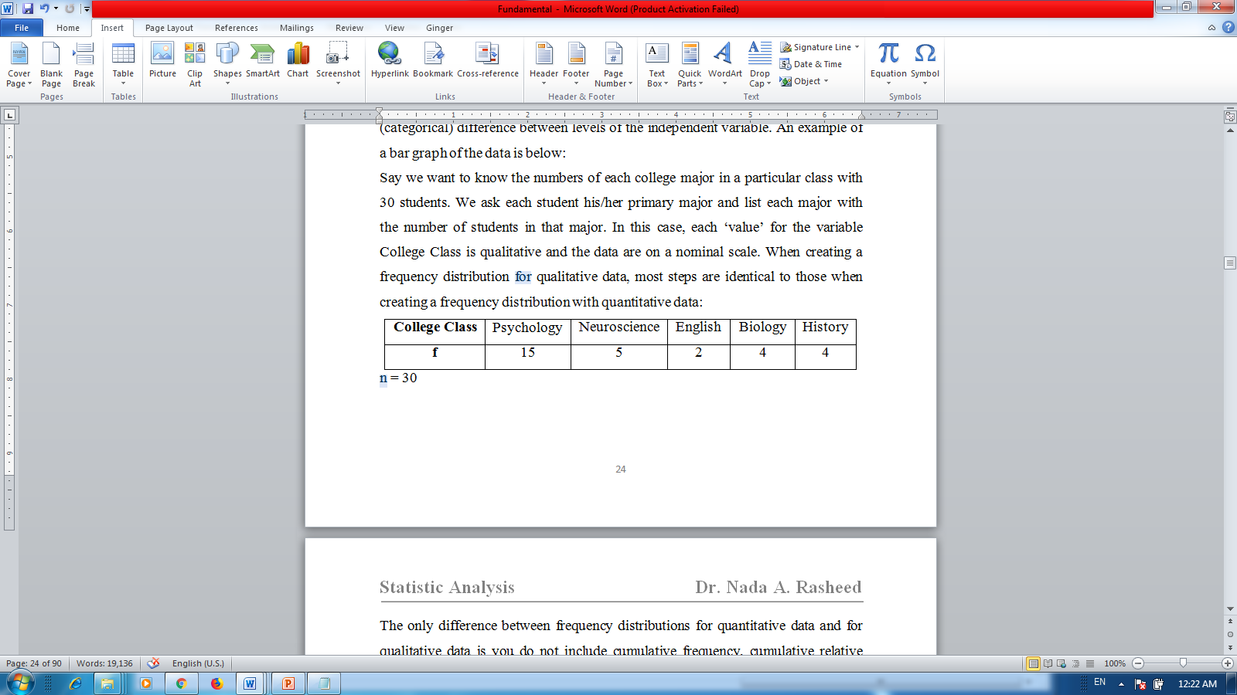
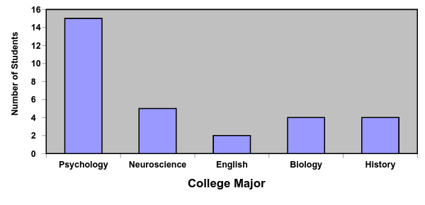
Frequency Distributions and Graphing

